Slide 1
create a website for online veterinary care for animal medical solutions system
​
Vamsi Krishna B – 192211659
Manikanta G - 192211665

Slide 2

Agenda
PROBLEM STATEMENT
ABSTRACT
INTRODUCTION
EXISTING SYSTEM
PROPOSED SYSTEM
MODULES DESCRIPTION (OPERATIONS)
SCREEN SHOTS
FUTUREENHANCEMENTS
CONCLUSION

Slide 3
PROBLEM STATEMENTS
Sure, here there are five points for the problem statement in online veterinary care for animal medical solutions system:-
Appointment Scheduling: Provide a seamless way for users to book, reschedule, and cancel veterinary appointments online.
Medical Records: Ensure secure access and management of pet medical histories and treatment plans.
Virtual Consultations: Offer telemedicine options for remote veterinary consultations via video, chat, or phone.
User-Friendly Design: Create an intuitive and accessible interface for both pet owners and veterinarians.
Educational Resources: Include a section with articles, FAQs, and guides on pet health and care.

Slide 4
ABSTRACT
Accessibility and Convenience: Highlight how the online veterinary care system provides easy access to veterinary services for pet owners, especially those in remote or underserved areas, ensuring timely medical consultations without the need for physical visits
Comprehensive Medical Solutions: Emphasize the range of services offered, including diagnosis, treatment plans, follow-ups, and emergency care, facilitated through video consultations, online chat, and digital health records.
Advanced Technology Integration: Discuss the use of modern technologies such as telemedicine platforms, AI-driven diagnostic tools, and electronic health records (EHR) to enhance the accuracy and efficiency of veterinary care.
User-Friendly Interface: Describe the intuitive and user-friendly design of the platform, ensuring that pet owners can easily book appointments, access medical records, and communicate with veterinarians. Integration: Combine insights from all analyses to improve detection accuracy.
Enhanced Monitoring and Follow-Up: Point out the system's capability for continuous monitoring of animal health through wearable devices and mobile apps, providing real-time updates and reminders for vaccinations, medications, and routine check-ups.

Slide 5
Introduction
Enhanced Accessibility: An online veterinary care system allows pet owners to access medical advice, consultations, and prescriptions from the comfort of their homes. This convenience ensures timely care and reduces the stress of transporting pets to clinics.
24/7 Support: With an online platform, you can provide round-the-clock support, accommodating different time zones and urgent needs. This continuous availability can significantly improve pet health outcomes and owner satisfaction.
Comprehensive Services: A well-designed website can offer a range of services, including virtual consultations, symptom checkers, medication management, and appointment scheduling. This integration helps streamline the care process and provides a holistic approach to veterinary services.
Data Security and Privacy: Ensuring the security of sensitive information is crucial. Implement robust data protection measures and comply with relevant regulations to safeguard client and pet information, building confidence in your online platform.
Technological Innovations: Introduce the cutting-edge technologies integrated into the system, such as AI-powered diagnostic tools, electronic health records (EHR), and IoT devices for monitoring pet health, which enhance the quality and efficiency of care.

Slide 6
EXISTING SYSTEM
Here are five concise points about the existing system for a website offering online veterinary care:
Limited Appointment Flexibility: Many current systems lack comprehensive online scheduling options, leading to inefficiencies and inconvenience for users.
Fragmented Medical Records: Medical records are often scattered across different platforms or are paper-based, making it challenging to maintain and access consistent pet health information.
Inadequate Telemedicine Options: Existing platforms may not fully support telemedicine, limiting remote consultation capabilities and access to veterinary care.
Complex User Interfaces: Current systems can be difficult to navigate, especially for non-tech-savvy users, leading to frustration and underutilization.

Slide 7
PROPOSED SYSTEM
Here are five concise points about the proposed system for a website offering online veterinary care:
Comprehensive Appointment Management: Provide an easy-to-use interface for booking, rescheduling, and canceling veterinary appointments online, with reminders and notifications.
Centralized Medical Records: Implement a secure, centralized system for maintaining and accessing digital medical records, ensuring consistency and accessibility for both pet owners and veterinarians.
Enhanced Telemedicine Features: Offer robust telemedicine capabilities, including video calls, chat, and document sharing for remote consultations and follow-ups.
User-Friendly Design: Design an intuitive and accessible website interface tailored to both tech-savvy and non-tech-savvy users, enhancing overall user experience.
Educational Resource Hub: Develop a comprehensive section with articles, FAQs, and guides on pet health, preventive care, and wellness, providing valuable information to pet owners.

Slide 8
MODULES DESCRIPTION
Here are five concise points about module descriptions (operations) for the website offering online veterinary care:
Appointment Management Module: Facilitate booking, rescheduling, and canceling appointments. Includes features like calendar integration, reminders, and notifications for both veterinarians and pet owners.
Medical Records Module: Securely store, update, and retrieve digital medical records. Allow veterinarians to add notes, upload test results, and manage treatment histories.
Telemedicine Module: Support virtual consultations through video calls, instant messaging, and file sharing. Enable veterinarians to diagnose and prescribe treatments remotely.
User Management Module: Handle user registration, authentication, and profile management for both pet owners and veterinarians. Ensure user data privacy and security.
Educational Resources Module: Provide a repository of articles, guides, and FAQs on pet health and care. Allow users to search, bookmark, and share educational content.

Slide 9
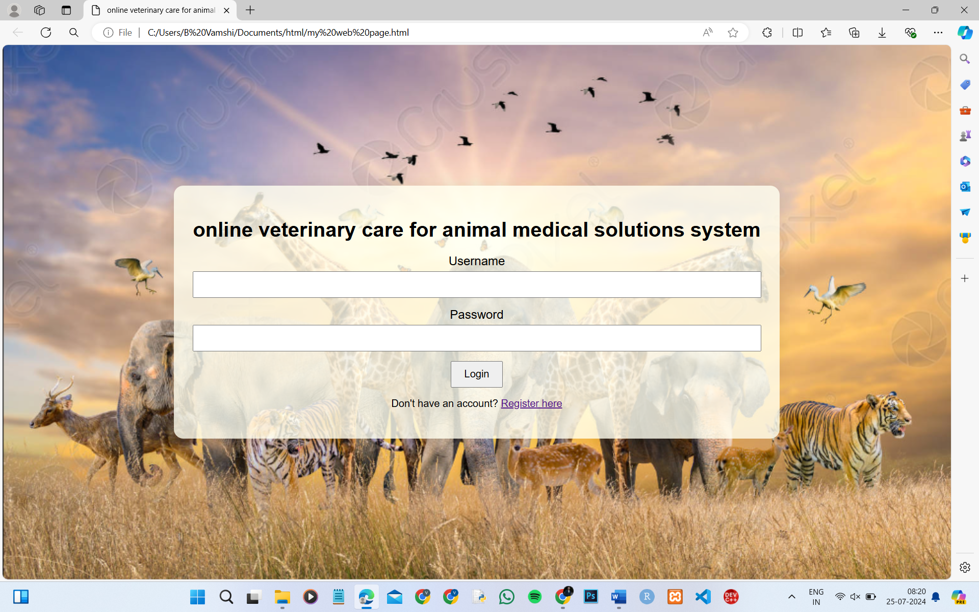
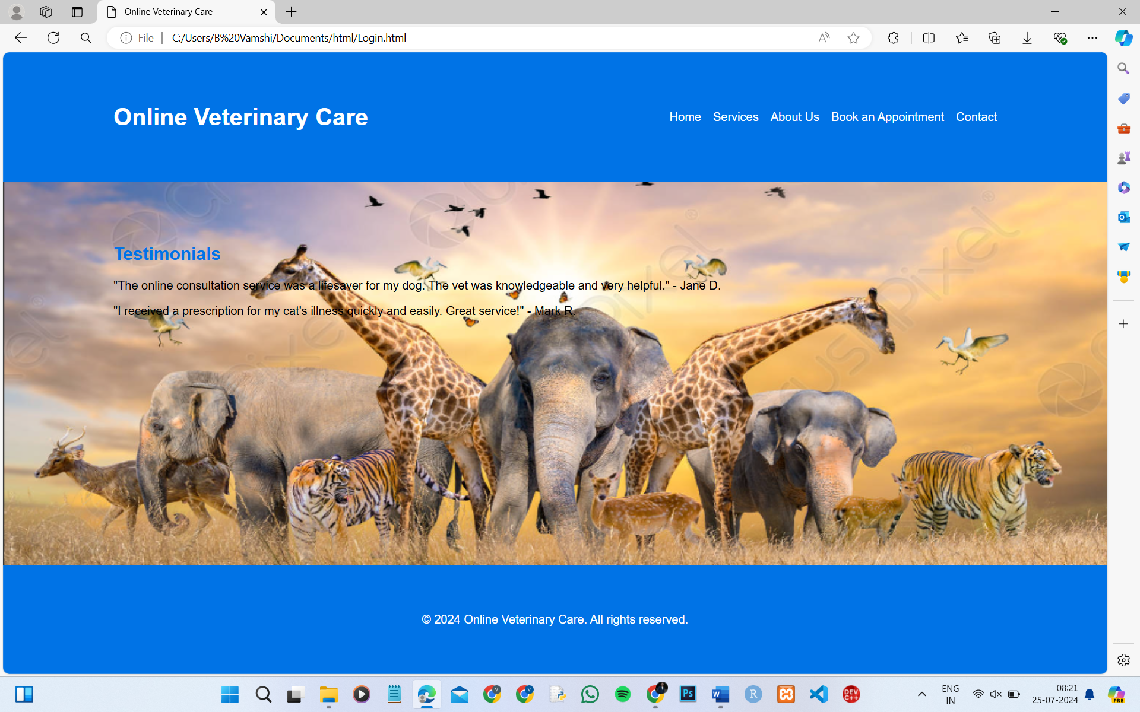
SCREENSHOTS

Slide 10
fUTUREENHANCEMENTS
Here are five concise points about future enhancements for a website offering online veterinary care:
AI-Powered Symptom Checker: Implement an AI-driven tool to help pet owners identify potential health issues based on symptoms before consulting a veterinarian.
Mobile App Integration: Develop a companion mobile app for easier access to services, including appointment management, medical records, and telemedicine features.
Advanced Analytics and Reporting: Introduce advanced analytics to provide insights on pet health trends, appointment patterns, and treatment outcomes, helping veterinarians make data-driven decisions.
Multi-Language Support: Add multi-language support to cater to a broader audience, ensuring accessibility for non-English speaking users.

Slide 11
CONCLUSION
Creating a website for online veterinary care offers a comprehensive and innovative solution to bridge the gap between pet owners and veterinary professionals. This platform provides a wide range of services, from remote consultations and medical records management to an online pharmacy and educational resources, all aimed at enhancing the quality of care for pets while providing convenience and accessibility to pet owners.

Slide 12
CREATE BY VAMSIKRISHNA BADISA

Slide 13
THANK YOU
ANY QUESTIONS PLEASE ASK?

